Slide 1
Accion Ministries
Improving lives in Mexico’s Yucatán peninsula
A partnership of Mexican & American Christians to build the body of Christ
Faith with Action = Acción

Slide 2
Ministries
Homes for education
Merida Student Home (CEM)
Mayan Children’s Village (VIM)
Building Projects with U.S. Work Teams
Church to Church building projects
Building and improving homes
Disaster Relief
All led by Accion Staff

Slide 3
Casa Estudantil Merida (CEM)
Merida Student Home
Enabling education of Engineers, Pastors and professionals since 1996
Room & board / scholarships for young men (Women being planned)
High school, college, and seminary degrees at schools in Merida
Christian environment / Service to God / Service to Others
__ students have benefited from CEM between 1996-2016

Slide 4
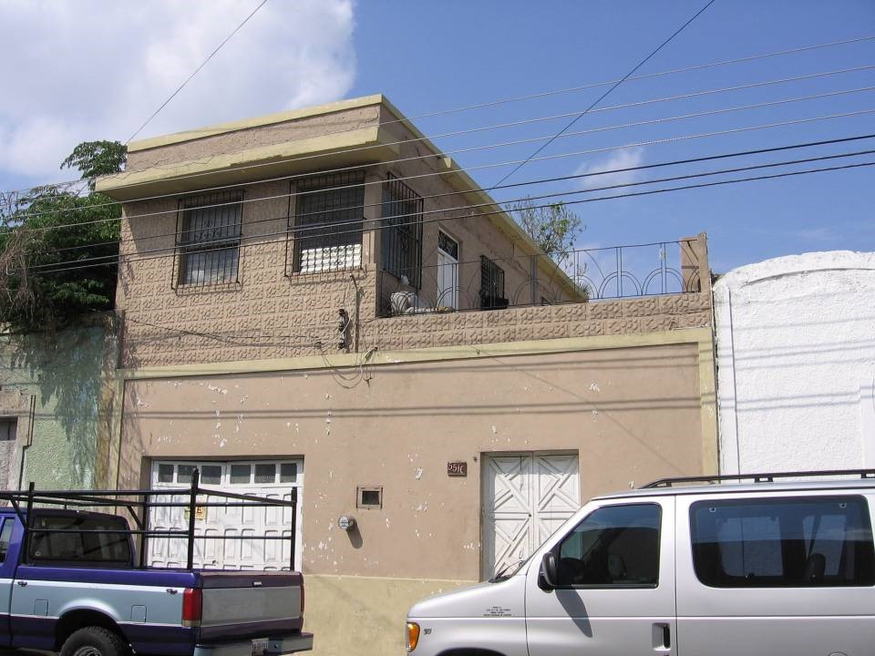
Casa Estudantil Merida (CEM)

Slide 5
Villa Infantil Maya (VIM)
Mayan Children’s Village
Enabling children to live and attend schools unavailable in their home villages since 2006
Room, board & transportation to school (and to their homes on weekends) provided
Traditional Mayan village atmosphere where students can learn about agriculture, livestock and scholastic education
Encourage Christian growth through education, worship & role models
__ students have benefitted from VIM between 2006 - 2016

Slide 6
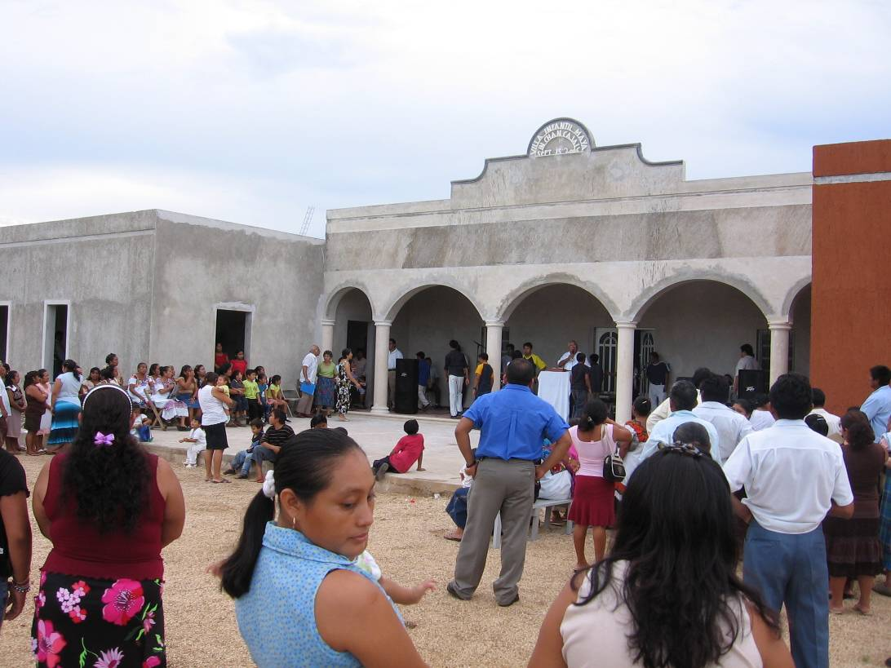
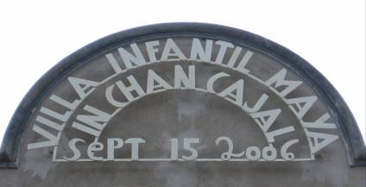
Mayan Children’s Village (VIM)
Notes:
Grand opening of VIM in 2006. Some of the board members FOA and guests from the US attended.

Slide 7
Building Projects with US Work Teams The life-blood of Accion
Church youth groups
Adult mission trips
College spring breaks
__ work teams since 1981
Church builds & improvements
Disaster relief
Vacation bible school with Mayan children
Craft activities with Mayan women
U.S. / Mexican church services

Slide 8
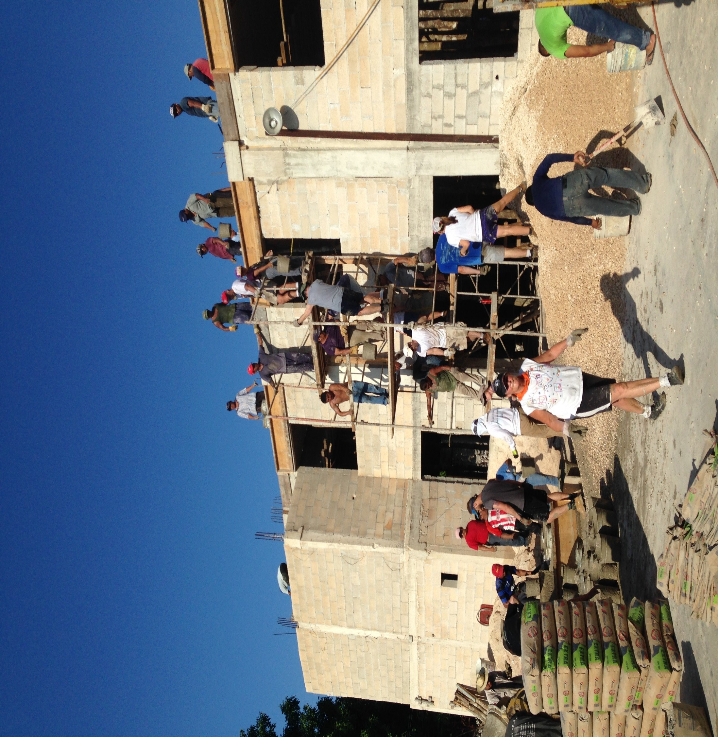
Work team from Covenant Presbyterian Church, Charlotte, North Carolina helping build a roof on a church in Kaua.

Slide 9
Accion Leadership
Founded by Rev. Oscar Dorantes, Sr.
1981 first work team
1988 Accion officially organized in Mexico
2008 retired
Now led by Oscar R. Dorantes, Jr.
Missionary of Mexican Presbyterian Church
Social Anthropologist
Seminary Training in U.S.

Slide 10
friends of Accion, inc. To render meaningful support to the charitable activities of Acción in the Yucatan Peninsula of Mexico with a view to advancing the well being of the people served and the Christian faith.
501(c)(3) non-profit charity
Support and accountability for Accion Ministries
Board members from Presbyterian and Lutheran churches in NC, VA, MS, ND, AZ.
Support from a broad number of reformed and congregational churches and individuals.
http://www.friendsofaccion.org/

Slide 11
How you can support Accion Ministries
Donations
Donation link: friendsofaccion.org
Mail checks made payable to “Friends of Accion”
Friends of Accion
c/o Covenant Presbyterian Church
1000 E. Morehead Street
Charlotte, NC 28204-2813
Sponsor a student “ Building Educational Chances through American Sponsors” (BECAs)
$140/month/student
Utilize donation options above
Send a mission work team
Contact Abby Gwaltney (abby.gwaltney@gmail.com) with questions or to sign up
Keep in touch
Friends of Accion facebook page /Semiannual newsletter
Pray for our ministries

Slide 12
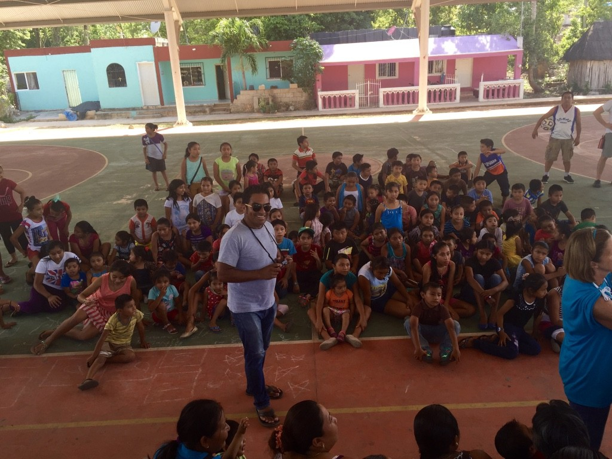
Make your life a mission, not an intermission.

